Slide 1
Scrum-agile
approach

Slide 2
Roles
Product Owner: “The Product Owner is responsible for maximizing the value of the product and the work of the Development Team (Cobb, 2015, 35).”
Scrum Master: “The Scrum Master is the servant-leader of the Scrum Team and is responsible for ensuring scrum is understood and enacted (Cobb, 2015, 36).”
Development Team: The Development Team consists of professionals who do the work of delivering a potentially releasable increment of “done” product at the end of each sprint (Cobb, 2015, 38).”

Slide 3
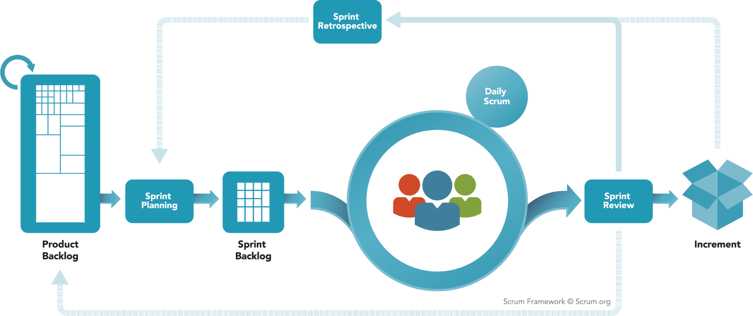
Scrum Framework

Slide 4

Product Backlog
The Product Backlog is completed by the Product Owner after talking to the customer.
The product backlog holds all items or stories that still need to be completed for a project.
The stories are put in order from most to least impactful/important.
Notes:
The Product Backlog is important to the scrum team because it hold all stories that need to be completed soon and the future. Future stories may be big picture and without much refinement.

Slide 5

Sprint Planning
Sprint Planning is two phases long
Phase 1 - Product Owner and Development Team decide what stories are part of sprint.
Phase 2 - Development team decides which tasks are needed to complete the selected stories.
Notes:
Sprint Planning is where the sprint backlog is formed. The product owner and development team decide which stories will fit into the allotted sprint timeline. Afterwards the development team uses phase 2 to break the stories into task to make the stories easier to understand for development.

Slide 6

Sprint and Daily Scrum
Sprint:
Sprints have a predetermined length
This is when development happens
Team members focus on most important stories first
Daily Scrum:
A Daily meeting for the Development team
Format
What was completed
Any issues from previous day
Next task to be started
Notes:
The sprint is where the development team works on the tasks the created in phase 2 of sprint planning. During the daily scrum team members discuss what they completed the day before if they are stuck on anything and they pains for the current day. This allows the team to see everyone's progress and input and to help others if they are stuck.

Slide 7

Sprint Review
Brief User Acceptance Test at end of each sprint
Development Team presents finished work to Product Owner for approval
Product Owner should have seen most if not all parts already
Good practice to include customer / executives
Notes:
This is the final acceptance test for finished work. The product owner should have already seen the work before this point to “sign” off on the function of each story. It may be beneficial to have the customer or executives be present during the review even though the product owner has the final say.

Slide 8

Sprint Retrospective
Similar to post-mortem of a tradition project
Lessons Learned
What went well
What went poorly
Notes:
Hands on learning during the sprint may happen but increasing the productivity of the sprint and team happens during the retrospective. This is when the team talks about what went well with the sprint and where there needs to be improvement.

Slide 9
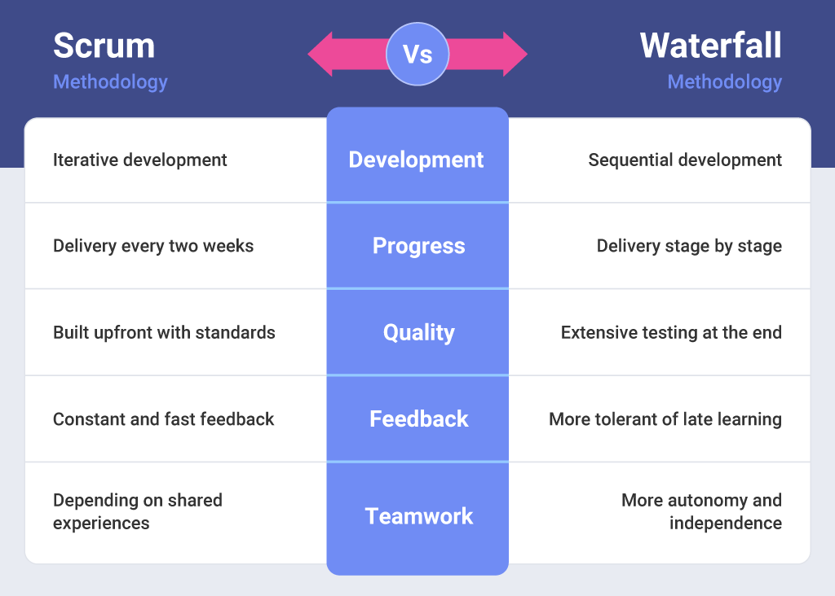
Notes:
During our SNHU Travel project we may not have been able to complete the product on time if using a waterfall method of planning. Since everything was tested before the change the customer wanted at the end of the sprint the team was capable of switch the end goal without adding more time to the sprint. If we had been using a waterfall method we would have still needed to test what was created before we would have been able to change product direction and would have increase development time.

Slide 10
References
Cobb, C. G. (2015). The Project Manager's Guide to Mastering Agile: Principles and Practices for an Adaptive Approach. Wiley.
Scrum.org(n.d). Scrum Framework [Infographic].Scrum.org The Home of Scrum. https://www.scrum.org/resources/what-is-scrum
Slingshot. (n.d). Scrum vs. Waterfall[Infographic]. Slingshot. https://www.slingshotapp.io/blog/scrum-vs-waterfall-how-to-choose-the-right-method-for-your-project#:~:text=If%20we%20must%20pinpoint%20the,clearly%20estimated%20costs%20and%20plan.

